Slide 1
Week 7 Notes
PHY495: Hoop Never Misses

Slide 2
What I’ve Done
Ran monte_carlo.py to find the optimal angle for a 2D two-point backboard
Ran it three times for 1000 simulations and got three different results: 1.3776532591487067, 1.507551763453968, 1.5195559981438695
Since these results differed, I decided to run it for 10000 simulations. This has been running for 5 days – I think it timed out because now isn’t showing up :/
Instead of running it for a set number of simulations, I decided to change it to run until the number of shots that hits the backboard exceeds a certain number. This way I can get a better sense of how many of the simulations are actually significant. (This code was still running Thursday night when I made the presentation) – getting this error message now

Slide 3
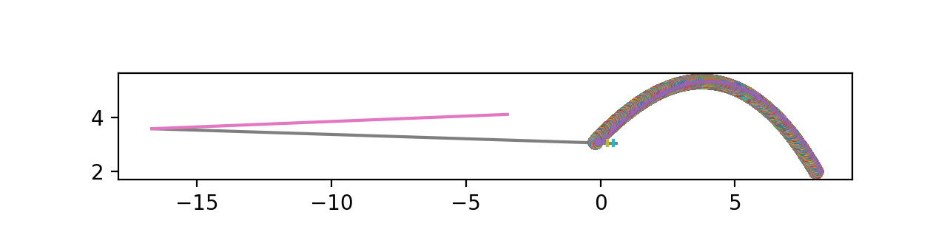
What I’ve Done
Created a function called move_points that splits the z range into n segments, finds the optimal angle for each of those segments based on a fixed bottom point and adds them together (explain this more)
The full version of this was still running Thursday night but I hard coded an example into it. This wasn’t a very good example because only one shot was used so it was hard to compare the best angle for just that one shot – gave a wrong result. I also tried to add a condition that redoes the optimization if the y value is greater than 2 in absolute value to avoid outliers like this.
Hopefully this will extend well to more angle points
The three point code was running for 2 days so I’m not sure if there’s a more effective way to do it that won’t take as long because for the actual backboard we’ll need a ton of points

Slide 4
What Worked
I now get email notifications whenever a job finishes (still not working for when there’s an error but I’ve been consistently checking in case there’s an error)
In submitting a job and also changing small things in the file I got several small errors that I was able to fix

Slide 5
What Didn’t Work
Code is taking so long to run

Slide 6
Where am I Stuck?
Walk through move_points function to see if logic makes sense
Is there a more efficient way to do the move_points function?

Slide 7
What Next?
Run code more
Extend move_points function to more points

